Slide 1
Kenton A. Fong Financial Analysis- Key Insights & Recommendations Portfolio Project: New Saas (Software-as-a-Service) Inc.
Purpose- The purpose of this project is to identify key business insights and recommendations for a hypothetical Saas (Software-as-a-service) company that can be presented to either the Sales, Marketing, and/or Product teams.
Resources- Several technological resources were used: SQL, Tableau software, Excel, Microsoft Word and PowerPoint.
Methodology- 1) Identified key financial data that is relevant to Sales and Marketing Teams, 2) designed initial layout and content of a sales database in Excel, 3) performed preliminary financial analysis, 4) uploaded data into SQL to obtain additional insights, 5) drafted key insights and recommendations, and 6) loaded data into Tableau to create various dashboard charts and graphs.
Date- February 7th, 2025
1

Slide 2
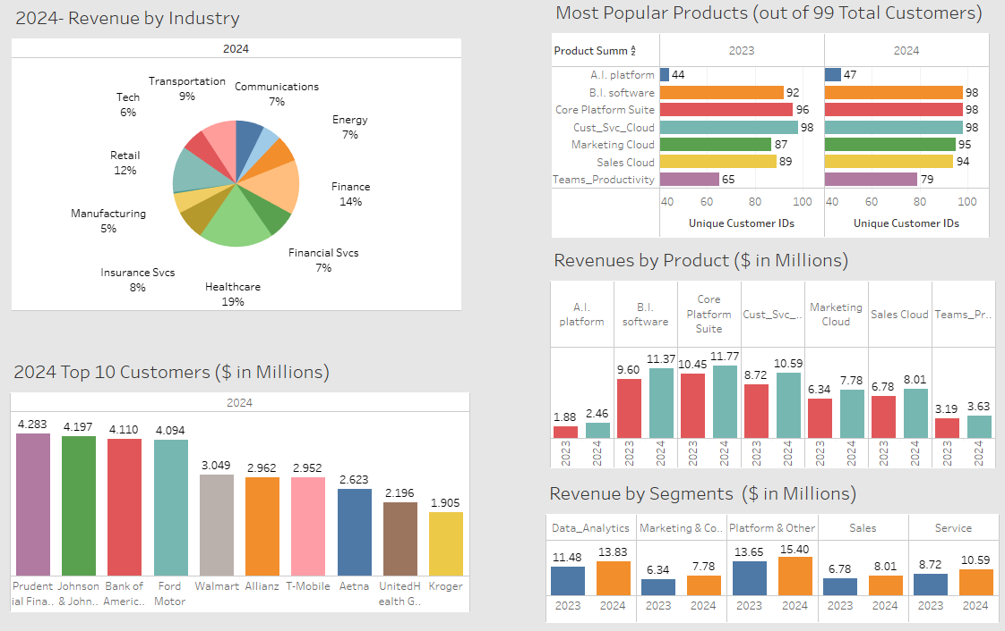
New Saas Co., Inc. - Dashboard Metrics
2

Slide 3
New Saas (Software-as-a-Service) Inc. Key Insights
Business Profile and Financial Highlights for the year 2024:
New Saas Inc. serves ninety-nine major corporate customers across the globe.
The top five customers in 2024 were: Prudential Services, Johnson & Johnson, Bank of America, Ford Motor Co., and Wal-Mart.
The top five customer service industries in 2024 were: Healthcare (19%), Finance (14%), Retail (12%), Transportation (9%), and Insurance Services (8%).
New Saas Inc. ended the year 2024 with a record $56 million in net subscription revenue, an 18% increase over the previous year.
Key Insights
New Saas Inc. provides seven major product solutions and two service subscription levels (Standard and Premium).
Artificial Intelligence platform, Business Intelligence software, Core Platform Suite, Customer Service Cloud, Marketing Cloud, Sales Cloud, and Teams Productivity.
New Saas Inc. offers three different customer support plans: Standard (level 1), Premier (level 2), and Signature (level 3).
In 2024, the average customer subscribed to six out of the seven product offerings, subscribed to the Standard level customer support plan, and had twenty-two individual user licenses.
In 2024, the Core Platform Suite generated the largest source of net subscription revenue at $11.8 million (or 21% of total company revenue). Business Intelligence software came in second place with $11.4 million (or 20%) of total company revenue.
3

Slide 4
New Saas (Software-as-a-Service) Inc. Key Insights
A detailed analysis of 2024 subscription revenue transactions revealed two additional revenue growth opportunities for the year 2025.
Opportunity # 1: Four specific products have the potential to generate additional revenue in the year 2025.
Forty-four customers could benefit from the A.I. Platform and may lead to $1.2 million in incremental revenue in 2025.
Fourteen customers could benefit from the Teams Productivity platform and may lead to $896 thousand in additional revenue in 2025.
Two customers could benefit from the Sales Cloud platform and may lead to $124 thousand in additional revenue in 2025.
Two customers could benefit from the Marketing Cloud platform and may lead to $138 thousand in additional revenue in 2025.
Opportunity # 2: Some customers could benefit by upgrading their customer support level from Standard to Premier. The majority of New Saas Inc. customers have a subscription to a Premium (level 2) product but only have a Standard (Level 1) customer support plan subscription.
Incremental customer support revenue in between the range of $399 thousand and $799 thousand could be realized in 2025 if these customers upgrade their customer support plan from Standard (Level 1) to Premier (Level 2).
If customers upgrade their support level to Signature (Level 3), then somewhere between $878 thousand and $1.8 million in additional revenue could be generated in 2025.
4

Slide 5
New Saas (Software-as-a-Service) Inc. Recommendations
Two recommendations should be considered for year 2025, as follows:
The Sales and Marketing Team should review the detailed report of customers appearing under Opportunity # 1. If a successful campaign to cross-sell these products to the current customer base is launched, these product cross-sells could lead to $2.4 million in incremental revenue in 2025.
2. For opportunity # 2, the Sales and Marketing Team should review the list of customers who have a Premium level subscription product but only have a Standard (Level 1) customer support plan. If these customers elect to upgrade their support plan levels, an estimated range between $399 thousand (conservative estimate) and $1.8 million (aggressive estimate) in additional revenue could be achieved in 2025.
5

Slide 6
New Saas Inc. (SQL Database- Overview and Major Analysis Steps)
Overview:
Purpose: Database used in reporting and analysis for a major Saas (Software as a Service) company.
Key Business Partners: Finance, Sales, Marketing, and Product teams.
Major Data Analysis Process Steps:
Review business & industry: Studied major Saas products on SalesForce CRM website; searched for industry average
gross margins for Saas companies.
Identify key business metrics: Sales by Product, Customer Support Plan levels, Top 10 Customers & Industries.
Create sample dataset: Retail sales data obtained from Kaggle website. Added missing data columns tied to metrics.
Data Cleaning: Designed data tables, identified primary keys and data types, clean and standardize data.
Upload data into database: Imported the .csv load files into each database table.
Build SQL queries: Used Primary Key fields to join each table. Summarized financial data by years.
Design Tableau dashboards
Insights & Recommendations
Upload to GitHub website: Drafted commentary for ReadMe sections; obtained https: internet hyper-links.
6

Slide 7
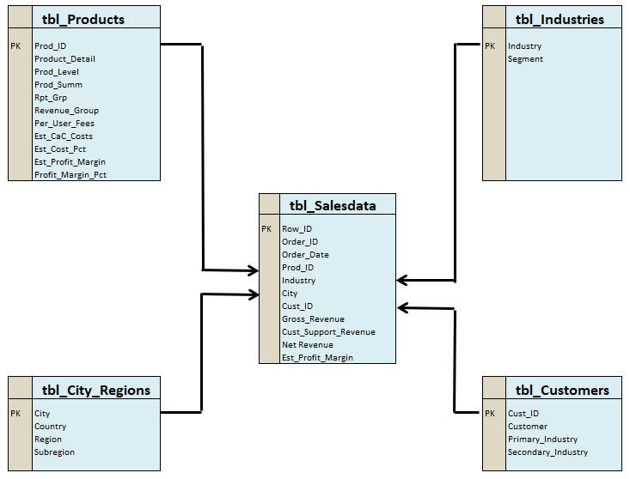
New Saas Inc. - SQL Database Design Overview (Table relationships)
7

